Slide 1


Mikhail Voloshin
September 16, 2021

Slide 2


Outline
Executive Summary
Introduction
Methodology
Results
Conclusion
Appendix
Just adding a cute little picture to apply my creativity to improve the presentation beyond the template.

Slide 3

Executive Summary
Summary of methodologies
Obtain data using
Web scraping via BeautifulSoup
REST API
Loading tables into DB2
Use exploratory analysis to get a “feel” for the data
SQL
Pandas with Matplotlib
Use visual tools to perform analytics
Visualize launch site locations with Folium
Build Interactive Visual Analytics Dashboard with Plotly Dash
Find patterns using Machine Learning algorithms with scikit-learn
Logistic regression
Support vector machine
Decision tree
K Nearest Neighbor
Summary of all results
Heavy rockets are more likely to crash
Rockets with high-orbit payloads are more likely to crash
Coastal launch sites have better recovery
Just adding a cute little picture to apply my creativity to improve the presentation beyond the template.

Slide 4

Introduction
Project background and context
We will predict if the Falcon 9 first stage will land successfully.
SpaceX advertises Falcon 9 rocket launches on its website with a cost of 62 million dollars; other providers cost upward of 165 million dollars each, much of the savings is because SpaceX can reuse the first stage.
Therefore if we can determine if the first stage will land, we can determine the cost of a launch.
Problems you want to find answers
What types of rockets land most successfully?
What launch sites result in more successful landings?
What payloads result in more successful landings?
What orbital targets result in more successful landings?
Just adding a cute little picture to apply my creativity to improve the presentation beyond the template.

Slide 5


Slide 6
Methodology
Executive Summary
Data collection methodology:
Data was loaded via HTTP from SpaceX’s REST API
Data was scraped from Wikipedia using BeautifulSoup
Data was loaded into a DB2 table from a CSV file
Perform data wrangling
We determined which outcomes we consider “good” and “bad”, and assigned a class for each launch

Slide 7
Methodology
Executive Summary
Perform exploratory data analysis (EDA) using visualization and SQL
Perform interactive visual analytics using Folium and Plotly Dash
Perform predictive analysis using classification models
Using Machine Learning algorithms with scikit-learn
Logistic regression
Support vector machine
Decision tree
K Nearest Neighbor

Slide 8
Data Collection
Describe how data sets were collected.
Data was loaded via HTTP from SpaceX’s REST API
Data was scraped from Wikipedia using BeautifulSoup
Data was loaded into a DB2 table from a CSV file
You need to present your data collection process use key phrases and flowcharts
REST API, BeautifulSoup, DB2 import from CSV

Slide 9
Data Collection – SpaceX API
Present your data collection with SpaceX REST calls using key phrases and flowcharts
Used Python requests library
Sent GET request to SpaceX REST API endpoint with proper path params and queryparams in the URL
Received JSON response
Used pandas to parse JSON into a dataframe
Add the GitHub URL of the completed SpaceX API calls notebook (must include completed code cell and outcome cell), as an external reference and peer-review purpose
https://github.com/omedalus/SpaceX-Capstone/blob/master/Week%201-a:%20Hands%20On%20Lab:%20Data%20Collection%20API.ipynb
Send GET request to SpaceX REST endpoint with path params in URL
Response (JSON)
Parse JSON with pandas
Dataframe

Slide 10
Data Collection - Scraping
Present your web scraping process using key phrases and flowcharts
Send GET request to Wikipedia URL
Receive response as HTML
Parse HTML with BeautifulSoup
Find all tables in the HTML
In the list of all tables, the first launch table will be the third one
For each row in the first launch table, for each column, parse the value. We hard-coded how each column should be parsed, i.e. whether it should be a number, date, string, etc.
Store the results in a dataframe
Add the GitHub URL of the completed web scraping notebook, as an external reference and peer-review purpose
https://github.com/omedalus/SpaceX-Capstone/blob/master/Week%201-b:%20Data%20Collection%20with%20Web%20Scraping.ipynb
Send GET request to Wikipedia URL
Response (HTML)
Parse HTML with BeautifulSoup
Soup object
Iterate over rows in third table on page,
and parse each value in each column
Dataframe

Slide 11
Data Wrangling
Describe how data were processed
We determined which outcomes we consider “good” and “bad”
We assigned a class for each launch
You need to present your data wrangling process using key phrases and flowcharts
Numpy and pandas
Landing outcome labels
value_counts
Add the GitHub URL of your completed data wrangling related notebooks, as an external reference and peer-review purpose
https://github.com/omedalus/SpaceX-Capstone/blob/master/Week%201-c:%20Hands-On%20Lab:%20Data%20Wrangling.ipynb
Read CSV
Dataframe
Create a landing outcome label
Dataframe with “class” landing outcomes

Slide 12
EDA with Data Visualization
Summarize what charts were plotted and why you used those charts
Charts plotted:
Histogram of Payload Mass vs. Flight Number
Histogram of Launch Site vs. Flight Number
Histogram of Launch Site vs. Payload Mass
Bar chart of successful landing (class) vs. Orbit
Orbit vs. Flight Number
Orbit vs. Payload Mass
Line Chart of Class vs. Year
Reasons why I used these charts
Because they are what the assignment came pre-populated with
Because they may reveal causative relationships between controllable factors (e.g. launch site, payload mass, etc.) and non-controllable ones (e.g. landing success)
Add the GitHub URL of your completed EDA with data visualization notebook, as an external reference and peer-review purpose
https://github.com/omedalus/SpaceX-Capstone/blob/master/Week%202-b:%20EDA%20with%20Visualization.ipynb

Slide 13
EDA with SQL
Using bullet point format, summarize the SQL queries you performed
Distinct launch sites
Top 5 records whose launch site started with “CCA”
Total payload mass launched by “NASA (CRS)”
Average payload by boosters version “F9 v1.1”
Date of first successful landing
Boosters which have succeeded in a drone landing with a payload between 4k and 6k
Total number of successes and failures
Booster versions which have carried the max payload
Failed landing_outcomes in drone ship, their booster versions, and launch site names for in year 2015
Count of landing outcomes (such as Failure (drone ship) or Success (ground pad)) between the date 2010-06-04 and 2017-03-20, in descending order¶
Add the GitHub URL of your completed EDA with SQL notebook, as an external reference and peer-review purpose
https://github.com/omedalus/SpaceX-Capstone/blob/master/Week%202-a:%20EDA%20with%20SQL.ipynb

Slide 14
Build an Interactive Map with Folium
Summarize what map objects such as markers, circles, lines, etc. you created and added to a folium map
Circles to mark launch sites
Markers to provide labels for launch sites
Lines from launch site to nearby “feature”, e.g. railway or highway or coastline
Explain why you added those objects
I added them because the assignment told me to
Add the GitHub URL of your completed interactive map with Folium map, as an external reference and peer-review purpose
https://github.com/omedalus/SpaceX-Capstone/blob/master/Week%203:%20Interactive%20Visual%20Analytics%20with%20Folium.ipynb

Slide 15
Build a Dashboard with Plotly Dash
Summarize what plots/graphs and interactions you have added to a dashboard
Dropdown to select launch site
Double-valued slider to select payload range
Pie chart to show the total successful launches count for all sites, or success vs. fail counts for one site if only one site is selected
Scatter chart to show the correlation between payload and launch success
Explain why you added those plots and interactions
Because that’s the requirement for the assignment?
Add the GitHub URL of your completed Plotly Dash lab, as an external reference and peer-review purpose
https://github.com/omedalus/SpaceX-Capstone/blob/main/spacex_dash_app.py

Slide 16
Predictive Analysis (Classification)
Instantiate a model
(Logistic, SVC, tree, KNN, etc)
Summarize how you built, evaluated, improved, and found the best performing classification model
Ran a GridSearchCV on…
Logistic Regression Classifier
Support Vector Classifier
Decision Tree Classifier
K Nearest Neighbors Classifier
You need present your model development process using key phrases and flowchart
Training Set
Testing Set
Add the GitHub URL of your completed predictive analysis lab, as an external reference and peer-review purpose
https://github.com/omedalus/SpaceX-Capstone/blob/master/Week%204:%20Machine%20Learning%20Prediction.ipynb
Model
Iterate over the hyperparameters of the model
Find the hyperparameters that have the best score
16

Slide 17
Results
Exploratory data analysis results
All models have a score of 0.83333333333…
Interactive analytics demo in screenshots
Would have been nice to have been told during the assignment instructions that we should take screenshots and save them for this final project
Predictive analysis results
Heavy rockets that travel farther have a lower chance of landing successfully. Duh.

Slide 18


Slide 19
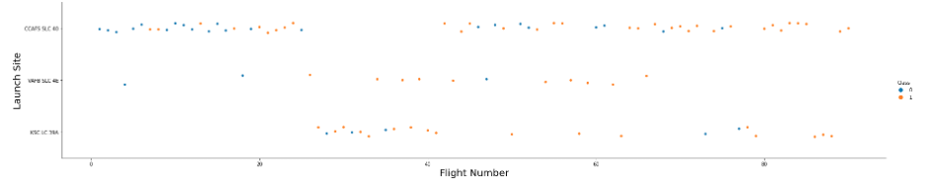
Flight Number vs. Launch Site
Show a scatter plot of Flight Number vs. Launch Site
In standard scientific presentation, this means plotting Flight Number on the Y axis and Launch Site on the X axis, which is the exact opposite of how we were instructed to do it in the lab.
I’ll plot both “Flight Number vs Launch Site” and also “Launch Site vs Flight Number” because it’s pretty obvious that whoever wrote these questions is either unable or simply unwilling to clearly specify what the heck they want.
Show the screenshot of the scatter plot with explanations
I think I’ve explained enough

Slide 20
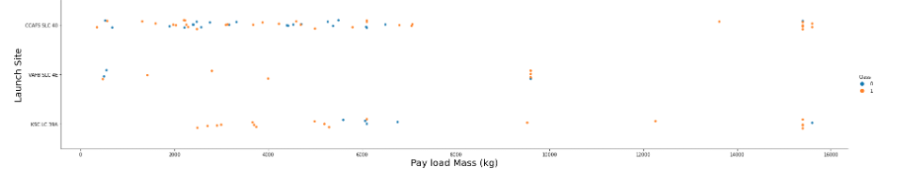
Payload vs. Launch Site
Show a scatter plot of Payload vs. Launch Site
Again, “Payload vs. Launch Site” means that Payload is on the Y axis and Launch Site is on the X axis, the exact opposite of what was asked for
I don’t know if the instructor wants us to re-plot the graph or if they simply mis-stated this request due to a poor grasp of how to communicate with scientific rigor.
Show the screenshot of the scatter plot with explanations
Done.

Slide 21
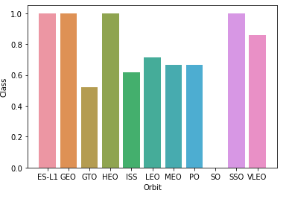
Success Rate vs. Orbit Type
Show a bar chart for the success rate of each orbit type
Okay
Show the screenshot of the scatter plot with explanations
The bar chart shows the success rate for each orbit type

Slide 22
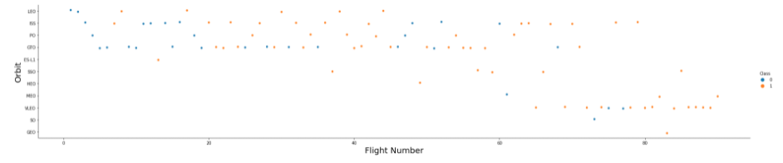
Flight Number vs. Orbit Type
Show a scatter point of Flight number vs. Orbit type
I’ve showed a scatter plot for both Orbit vs. Flight Number and also Flight Number vs. Orbit, because I don’t think the instructor knows what he’s asking for.
Show the screenshot of the scatter plot with explanations
Yeah, I did that.

Slide 23
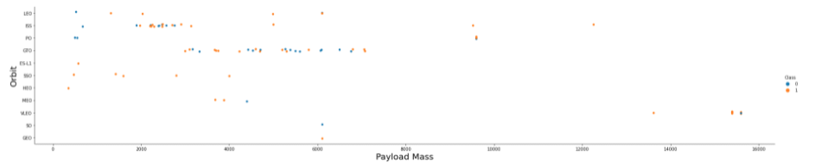
Payload vs. Orbit Type
Show a scatter point of payload vs. orbit type
Here’s a plot of orbit vs. playload, and also a plot of payload vs. orbit. This game is getting really tiresome.
Show the screenshot of the scatter plot with explanations
Done.

Slide 24
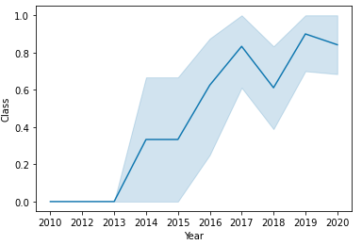
Launch Success Yearly Trend
Show a line chart of yearly average success rate
At least he didn’t ask for “Year vs. Class”, which would have been the sideways version of this.
Show the screenshot of the scatter plot with explanations
What does this look like?

Slide 25
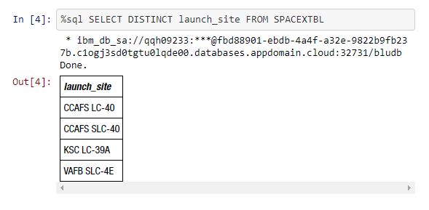
All Launch Site Names
Find the names of the unique launch sites
CCAFS LC-40
CCAFS SLC-40
KSC LC-39A
VAFB SLC-4E
Present your query result with a short explanation here
Query: SELECT DISTINCT launch_site FROM SPACEXTBL
Explanation: I select distinct values of “launch_site” from table “SPACEXTBL”

Slide 26
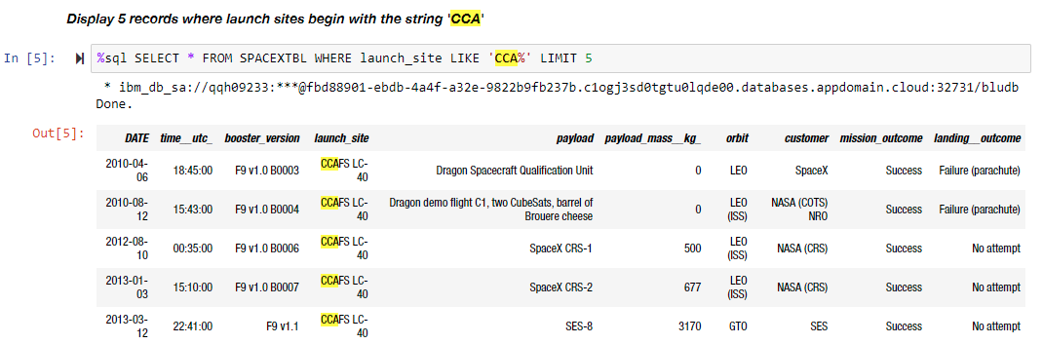
Launch Site Names Begin with 'CCA'
Find 5 records where launch sites begin with `CCA`
Records shown in screenshot
Present your query result with a short explanation here
Query: SELECT * FROM SPACEXTBL WHERE launch_site LIKE 'CCA%' LIMIT 5
Explanation: I select the first 5 records where the value of “launch_site” starts with CCA
I’m deeply impressed that, for once, the question requested in this final assignment actually corresponds to the task performed in the lab

Slide 27
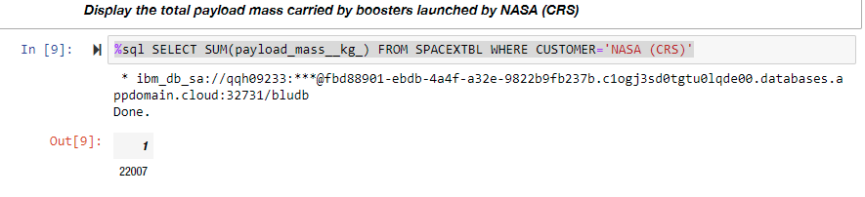
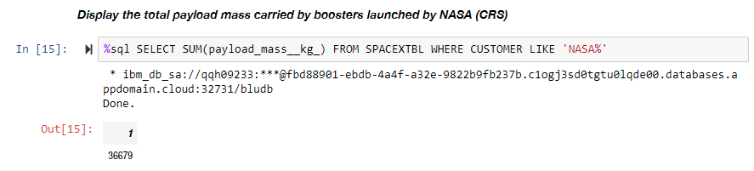
Total Payload Mass
Calculate the total payload carried by boosters from NASA
Carried by “NASA (CRS)”, as per the assignment instructions: 22,007
Carried by NASA in general, as per this question (which is different from what was asked for in the assignment): 36,679
Present your query result with a short explanation here
QUERY (1): SELECT SUM(payload_mass__kg__) FROM SPACEXTBL WHERE CUSTOMER=‘NASA (CRS)’
QUERY (2): SELECT SUM(payload_mass__kg__) FROM SPACEXTBL WHERE CUSTOMER LIKE ‘NASA%’
Explanation:
The lab assignment asked us to calculate the total payload carried by boosters specifically from NASA (CRS).
This questions asks us to calculate the total payload carried by boosters from NASA in general, which is a superset of boosters from NASA (CRS).
I’ve presented both results here because the instructors seem incapable of asking for whatever it is that they actually want, and I’ll be damned if I’m docked points due to their inability to communicate.

Slide 28
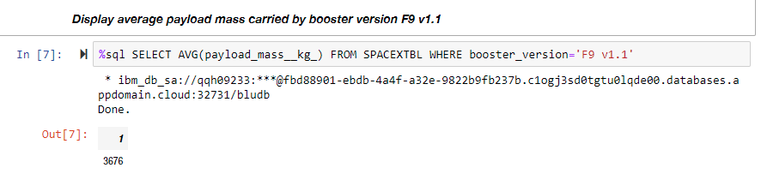
Average Payload Mass by F9 v1.1
Calculate the average payload mass carried by booster version F9 v1.1
3,676
Present your query result with a short explanation here
Query: SELECT AVG(payload_mass__kg__) FROM SPACEXTBL where booster_version=‘F9 v1.1’
Explanation: I’m extremely confused as to what’s happening here. In this particular case, for once, the question presented here in the final assignment seems to be exactly what was requested in the original lab. This is highly abnormal and makes me suspect that some sort of trick is occurring.

Slide 29
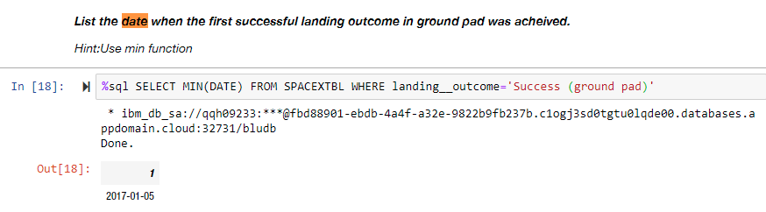
First Successful Ground Landing Date
Find the dates of the first successful landing outcome on ground pad
2017-01-05
Present your query result with a short explanation here
Query: SELECT MIN(DATE) FROM SPACEXTBL WHERE landing__outcome='Success (ground pad)’
Explanation: I select the minimum date from the table SPACEXTBL where the value of the field “landing__outcome” is equal to the string “Success (ground pad)”. Come on, why are we doing this?

Slide 30
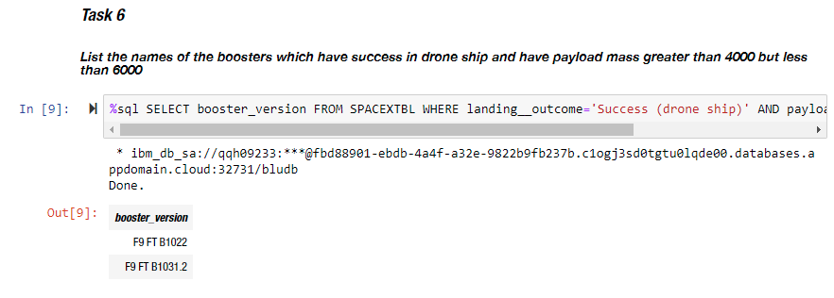
Successful Drone Ship Landing with Payload between 4000 and 6000
List the names of boosters which have successfully landed on drone ship and had payload mass greater than 4000 but less than 6000
F9 FT B1022
F9 FT B1031.2
Present your query result with a short explanation here
Query: SELECT booster_version FROM SPACEXTBL WHERE landing__outcome='Success (drone ship)' AND payload_mass__kg_ BETWEEN 4000 AND 6000
Explanation: Dude. Come on. Fine. I select booster_version from the table SPACEXTBL where the value of the field “landing__outcome” is “Success (drone ship)” and the value of the field “payload_mass__kg_” is between 4000 and 6000.
This farce is demeaning to us both. It’s pretty obvious that the instructors gave absolutely no thought into structuring these questions, and literally cut-and-pasted their way through this entire course curriculum. It’s insulting to us that they should expect us to not do likewise.

Slide 31
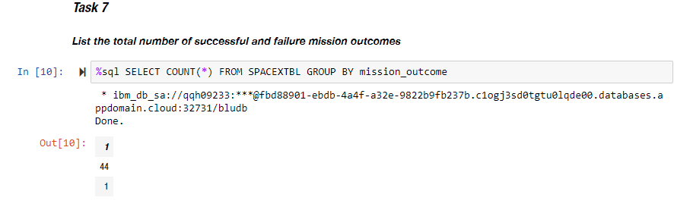
Total Number of Successful and Failure Mission Outcomes
Calculate the total number of successful and failure mission outcomes
Success: 44
Failure: 1
Present your query result with a short explanation here
Query: SELECT COUNT(*) FROM SPACEXTBL GROUP BY mission_outcome
Explanation: I count the mission outcomes come on are you freaking kidding me look at the sql code it’s simpler than plain English

Slide 32
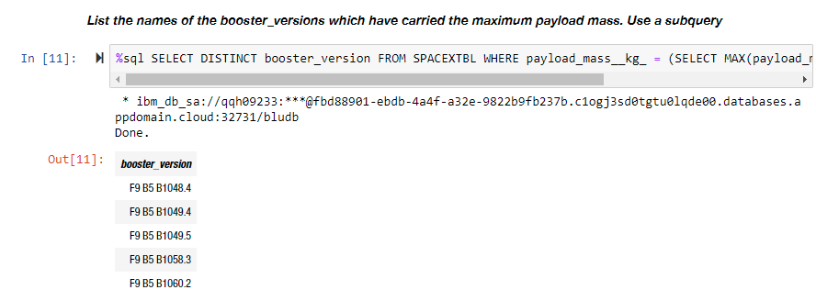
Boosters Carried Maximum Payload
List the names of the booster which have carried the maximum payload mass
F9 B5 B1048.4
F9 B5 B1049.4
F9 B5 B1049.5
F9 B5 B1058.3
F9 B5 B1060.2
Present your query result with a short explanation here
Query: SELECT DISTINCT booster_version FROM SPACEXTBL WHERE payload_mass__kg_ = (SELECT MAX(payload_mass__kg_) AS maxpayload FROM SPACEXTBL)
Explanation: I’m done playing this game. Give me whatever score you feel appropriately reflects how well you believe I understand the subject matter.

Slide 33
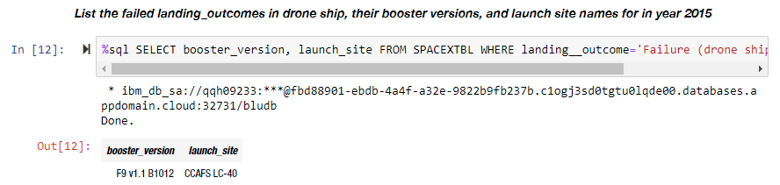
2015 Launch Records
List the failed landing_outcomes in drone ship, their booster versions, and launch site names for in year 2015
booster_version: F9 v1.1 B1012 launch_site: CCAFS LC-40
Present your query result with a short explanation here
SELECT booster_version, launch_site FROM SPACEXTBL WHERE landing__outcome='Failure (drone ship)' AND DATE LIKE '2015%’
Explanation: Come on.

Slide 34
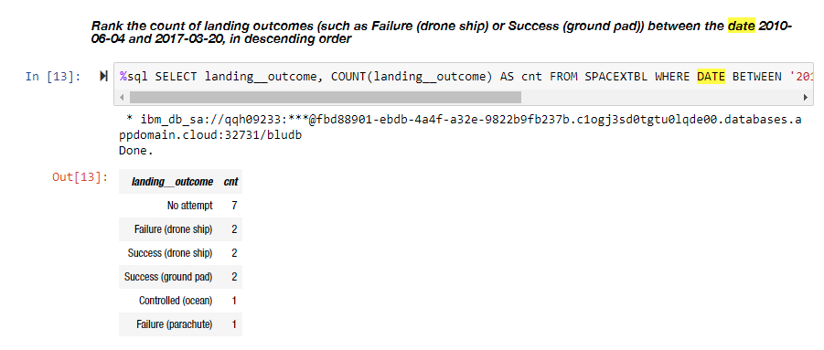
Rank Landing Outcomes Between 2010-06-04 and 2017-03-20
Rank the count of landing outcomes (such as Failure (drone ship) or Success (ground pad)) between the date 2010-06-04 and 2017-03-20, in descending order
No attempt 7
Failure (drone ship) 2
Success (drone ship) 2
Success (ground pad) 2
Controlled (ocean) 1
Failure (parachute) 1
Present your query result with a short explanation here
Query: SELECT landing__outcome, COUNT(landing__outcome) AS cnt FROM SPACEXTBL WHERE DATE BETWEEN '2010-06-04' AND '2017-03-20' GROUP BY landing__outcome ORDER BY cnt DESC
Explanation: Provided sufficiently as needed.

Slide 35


Slide 36
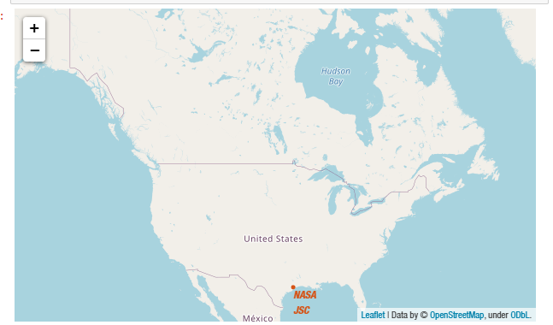
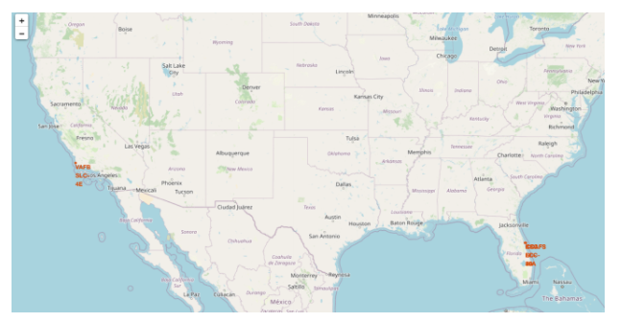
Folium plot of first or maybe second map
Replace <Folium map screenshot 1> title with an appropriate title
Ok. Do you mean literally the first map, which only shows NASA JSC? Or do you mean the second map, which includes multiple launch sites?
Explore the generated folium map and make a proper screenshot to include all launch sites’ location markers on a global map
Ok. I have shown map markers on both the first and the second maps.
Explain the important elements and findings on the screenshot
In the first map, they show the Corpus Christi (near-ish to Houston) launch site. In the second one, they show the launch sites in Florida and California.

Slide 37
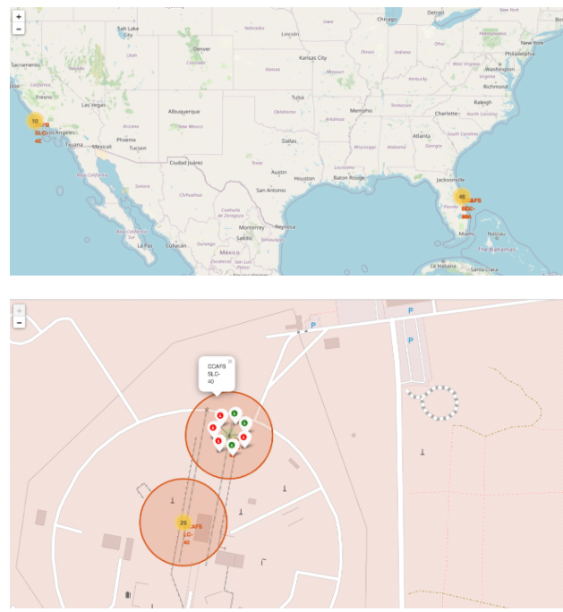
Color-labeled launch outcomes
Replace <Folium map screenshot 2> title with an appropriate title
Ok. It’s not actually the second map; it’s the third. But whatever.
Explore the folium map and make a proper screenshot to show the color-labeled launch outcomes on the map
Done.
Explain the important elements and findings on the screenshot
The successful launches are green. The failures are red.

Slide 38
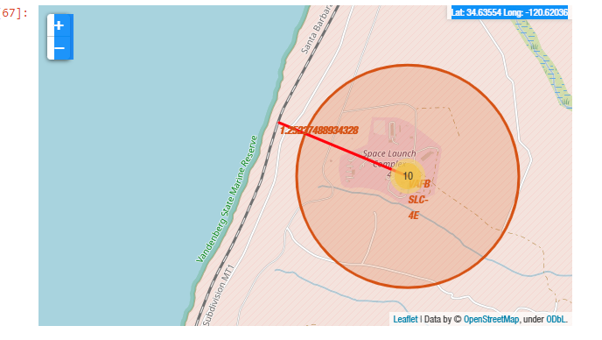
Distance from launch site to railway
Replace <Folium map screenshot 3> title with an appropriate title
Ok
Explore the generated folium map and show the screenshot of a selected launch site to its proximities such as railway, highway, coastline, with distance calculated and displayed
Ok
Explain the important elements and findings on the screenshot
This screenshot shows very important elements because it is very important to know that the very important VAFB SLC-4E launch site is 1.25237488934328 km away from the nearest very important railway.

Slide 39


Slide 40
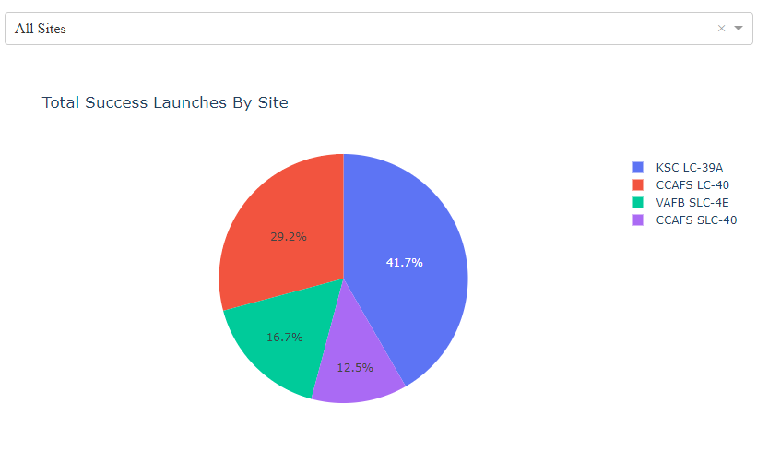
Plotly Dash Launch Success Count For All Sites
Replace <Dashboard screenshot 1> title with an appropriate title
Sure, whatever
Show the screenshot of launch success count for all sites, in a piechart
Shown
Explain the important elements and findings on the screenshot
There are no “important” elements, because this chart is not important. But there is a pie chart, a title, a color key, and a selection dropdown.

Slide 41
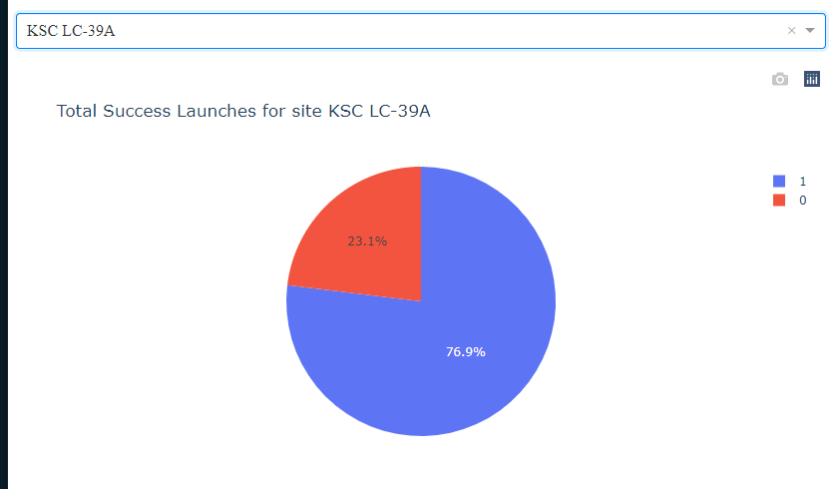
KSC LC-39A has highest success ratio
Replace <Dashboard screenshot 2> title with an appropriate title
Ok
Show the screenshot of the piechart for the launch site with highest launch success ratio
KSC LC-39A has the highest success ratio, with 76.9% success
Explain the important elements and findings on the screenshot
There is a pie chart, a title, a color key, and a selection dropdown.

Slide 42
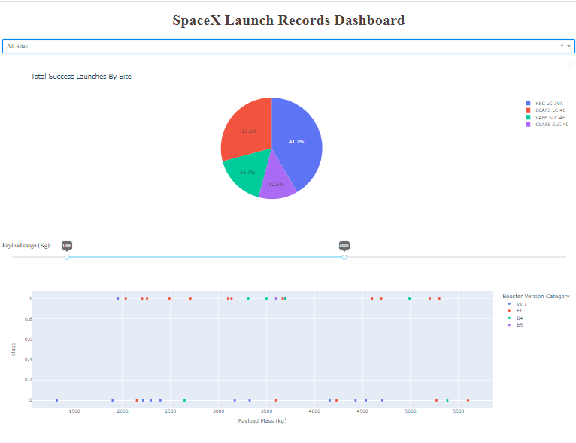
Launch Outcome vs. Payload Mass for All Launch Sites
Replace <Dashboard screenshot 3> title with an appropriate title
Ok
Show screenshots of Payload vs. Launch Outcome scatter plot for all sites, with different payload selected in the range slider
For the last time, it’s “Y vs. X”, not “X vs. Y”. We do not have a chart of “Payload vs. Launch Outcome”, for heaven’s sake. We do have a chart of Launch Outcome vs. Payload, which I have attached.
Explain the important elements and findings on the screenshot, such as which payload range or booster version have the largest success rate, etc.
There is a pie chart, a title, a color key, and a selection dropdown.
FT boosters seem to have a high rate of success when delivering small payloads.

Slide 43


Slide 44
Classification Accuracy
Visualize the built model accuracy for all built classification models, in a bar chart
Is this a joke? They all scored 83.3%
Find which model has the highest classification accuracy
All models scored 83.3%.
83.3%
Logistic
SVM
DecTree
KNN

Slide 45

Confusion Matrix
Show the confusion matrix of the best performing model with an explanation
Of the 18 test cases…
12 were predicted to land and did indeed land
3 were predicted to land but did not land
3 were predicted to not land and did indeed not land
0 were predicted to not land but did indeed land

Slide 46
Conclusions
Point 1
The instructors don’t understand the difference between a plot of “Y vs. X” and “X vs. Y”
Point 2
The instructors expected every single one of us to spend more time and do more work on this assignment than they themselves did in organizing it. The instructors copy-pasted the majority of the slides in this presentation.
Point 3
Rockets with larger payloads and higher-orbit deployment targets are less likely to land successfully, which is, like, duh.
Point 4
Newer rockets (higher version designations) are more likely to land successfully, which, again, we should darn well hope so.

Slide 47
Appendix
Include any relevant assets like Python code snippets, SQL queries, charts, Notebook outputs, or data sets that you may have created during this project
All code, queries, charts, etc. are in my GitHub repository https://github.com/omedalus/SpaceX-Capstone/tree/master

Slide 48


